Slide 1
Toolkit- 3x5 card, add info
Ch 5 Goal: To calculate the quantities of chemicals used/needed or produced in a chemical reaction.
Avogadro’s #
Scale from atomic scale to measurable (visible) scale
Molar Mass
Convert from masses (g) to numbers (mol)
Chemical Formula Ratios
Convert from numbers of one atom or molecule to numbers of another
Mass Percent
Convert from masses of one thing to masses of another

Slide 2
Examples done on board
Calculate the Number of Atoms in 2.45 Mol of Copper.
How many moles of water have a mass of 16.2 g?
How many aluminum atoms are in an aluminum can with a mass of 16.2 g?
How many moles of hydrogen are in the moles of water from #2?

Slide 3
Do in Study Group
Calculate the Number of moles in 2.78 x10²⁴ atoms of Copper.
How many grams of water would 1.27 moles weigh?
What would be the mass (in g) of 2.78 x10²⁴ atoms of aluminum?
How many moles of hydrogen are in the 5.20 moles of ammonia (NH₃)?

Slide 4
Mass Percent Composition
Can be determined from:
The formula of the compound.
The experimental mass analysis of the compound.

Slide 5
Find the Mass Percent of Cl in C₂Cl₄F₂.

Slide 6
Find the Mass Percent of Cl in C₂Cl₄F₂.
Given:
Find:
C₂Cl₄F₂
% Cl by mass
Solution Map:
Relationships:
Solution:
Check:
Since the percentage is less than 100 and Cl is much heavier than the other atoms, the number makes sense.

Slide 7
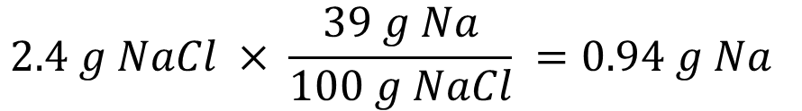
Mass Percent as a Conversion Factor
Mass % can be used as a conversion factor.
NaCl is 39% Na
100 g NaCl : 39 g Na
How many grams of sodium are in 2.4 g NaCl?
$$2.4 g NaCl × \frac{39 g Na}{100 g NaCl} =0.94 g Na$$

Slide 8
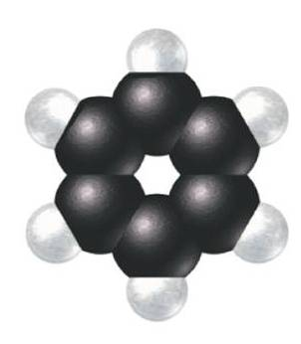
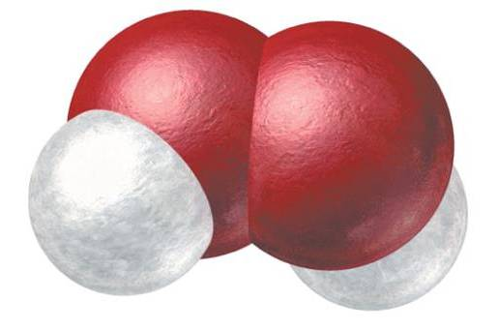
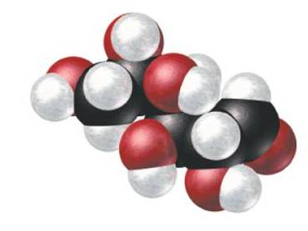
Empirical Formulas
The simplest, whole-number ratio of atoms in a molecule is called the empirical formula.
Hydrogen Peroxide
Molecular formula = H₂O₂
Empirical formula = HO
Benzene
Molecular formula = C₆H₆
Empirical formula = CH
Glucose
Molecular formula = C₆H₁₂O₆
Empirical formula = CH₂O

Slide 9
Finding an Empirical/Molecular Formula
(Empirical Formula)
(Molecular Formula)
Masses or Mass Ratio
Simplest Whole # Ratio
Actual Whole # Ratio
Moles
- Ionic Compounds are always written using the simplest whole # ratio, so you will stop with the empirical formula.
- Molecular Compounds can have different ratios, but the chemical formula will always be some multiple of the Empirical Formula.
Tro: Chemistry: A Molecular Approach, 2/e

Slide 10
Example
(Empirical Formula)
(Molecular Formula)
Masses or Mass Ratio
Simplest Whole # Ratio
Actual Whole # Ratio
Moles
Example 3.18: Find the molecular formula of butanedione(86.10 g/mol), given that it’s mass composition is 55.8% C, 7.04% H, and 37.2% O.
Answer: C₄H₆O₂

Slide 11
Transition Slide- Ch 6 Material
Chapter 6 is about understanding bonding in molecular compounds and using that to predict physical properties of those molecules.

Slide 12
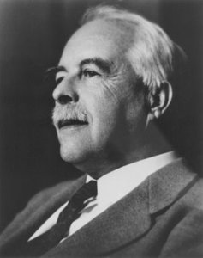
Gilbert Lewis
1875-1946
Developed Lewis Structures and many other things.
Nominate for the Nobel Prize 41 times, but never won.
His proteges won 5 Nobel Prizes
His death is a mystery- it is assumed to be a suicide because it appeared suspicious and he was very depressed after having lunch with a rival who had just been awarded a Nobel prize

Slide 13
Lewis Structures
A model showing outer shell (valence) electrons.
Help us predict a molecule’s properties
Lewis
Structures
(Show the bonds in a molecule)
Molecular
Polarity
+ EN
Molecule
Shapes
Molecule
Properties

Slide 14
Lewis Symbols of Atoms
Dots around the symbol represent valence electrons.
Puts one electron on each side first, then pair.
•
••
••
••
••
Li• Be• •B• •C• •N• •O: :F: :Ne:
•
•
•
•
•
•
••

Slide 15
Ions and Ionic Compounds
Cations- shown without valence electrons.
Anions- shown with 8 valence electrons.
Ionic Compounds- cations and anions shown next to each other.
MgF₂
Li• → Li⁺
••
••
:F: → [:F:]⁻
•
••
••
Mg²⁺ 2[:F:]⁻
••

Slide 16
Best Practices for Drawing Lewis Structures of molecular compounds & polyatomic ions
Draw the molecule’s “Skeleton”
Central atom is usually least EN or “odd element” (never hydrogen)
Count Valence Electrons
Place electrons on molecule in pairs, starting with outer elements to give each atom an octet (duet for hydrogen).
If a central atom does not have a full octet, move lone pairs in as bonds.

Slide 17
Practice—Lewis Structures
P₂H₄
NO₂⁻¹
H₃PO₄
17

Slide 18
Practice—Lewis Structures, Continued
P₂H₄
NO₂⁻¹
H₃PO₄
18

